Slide 1
Non-parametric methods for PDF estimation

Slide 2
Bibliography
Density estimation for statistics & data analysis
Silverman, B.W. (1986) CRC press
See Google books
http://books.google.es/books?vid=ISBN0412246201

Slide 3
PDF estimation: goal
Obtain an estimation of the PDF from the data in the sample
Types of methods:
Parametric: they start from a functional form of the PDF (e.g. a physical model) and fit its parameters using the sample (e.g. maximum likelihood)
Non parametric: try to model the PDF without making any hypothesis about its functional form

Slide 4
For simplicity we will study the univariate case:
Random variable x
PDF f(x)
Probability
Sample: x₁, …, x_{n}

Slide 5
Histograms
It’s the oldest method and the most used
Given an origin x₀ and a width h we count the objects inside each interval [x₀+ih,x₀+(i+1)h] i=0,1,2, …
We estimate the PDF as
where n is the total number of objects

Slide 6
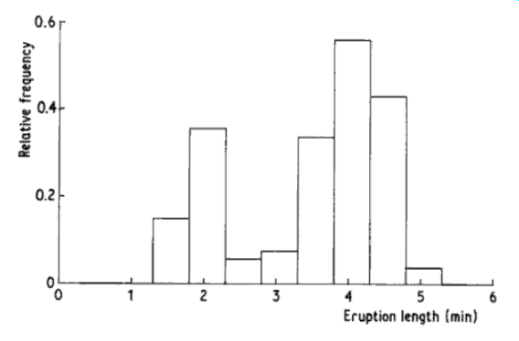
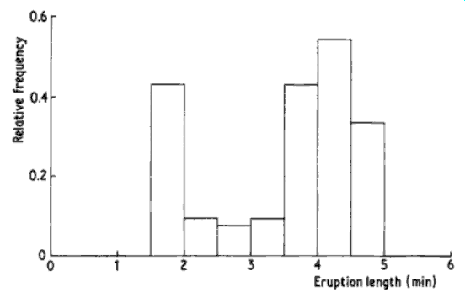
Disadvantages:
Very convenient for 1D data, but unpractical for multidimensional data
The estimation of the PDF is discontinuous
Is very dependent of the origin and width chosen

Slide 7
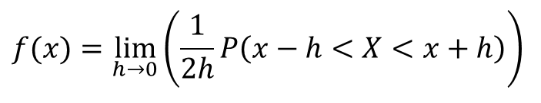
Simple estimator
Starting from the definition of the PDF
We fix a small width h and define a “natural” estimator of the PDF
$$f(x)=\lim_{h→0}\left(\frac{1}{2h}P\left(x−h<X<x+h\right)\right)$$

Slide 8
It is usually expressed in the following way:
Weight function
Estimator
It is the sum over the sample of “boxes” centered in each one of the observations; is a kind of histogram where each point is the center of a sampling interval.

Slide 9
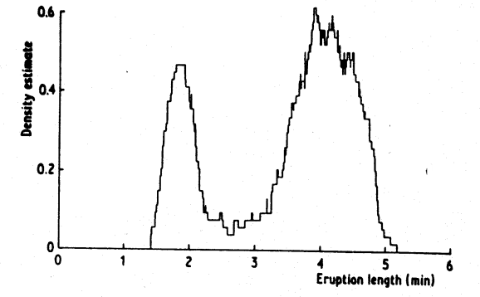
Advantages:
It does not depend on any origin
Disadvantages:
Depends of the chosen width h
The estimation of the PDF is discontinuous

Slide 10
Kernel estimator
Starting from the simple estimator, the weight function is substituted by a kernel function κ(x) such that
(normalized)
and the estimator of the PDF is
where h is the window width or smoothing parameter

Slide 11
Advantages:
This PDF estimator has all the continuity and differentiability properties of the kernel function
Disadvantages:
Depends of the chosen width h
For sparse samples small values of h tend to produce spurious spikes
For large values of h the details of the PDF are lost (smoothed out)

Slide 12
Example:
A gaussian kernel function: we are representing the PDF as a sum of gaussians centered in each one of the observations and a width determined by the h parameter

Slide 13
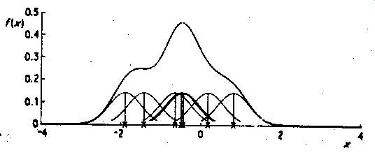
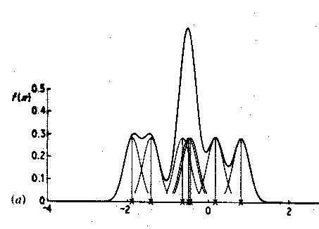
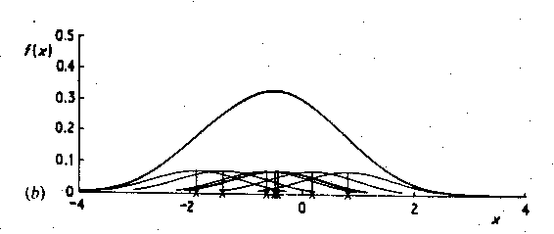
h=0.4
h=0.2
h=0.8

Slide 14
Nearest Neighbor estimator
Aims to adapt the smoothing to the local density of the data
For each point x of the possible range of values calculate and sort the distances to the points in the sample
d₁ ≤ d₂ ≤ … ≤ d_{k} ≤ d_{k+1} …
Choose the smoothing factor k, a small integer, typically
x
x_{a}
x_{b}
x_{c}
x_{d}
x_{e}
x_{f}

Slide 15
Define the PDF estimator as
The idea is that with this definition the density of observations in an interval 2d_{k}(x) around x is just k:
It’s like defining a simple estimator where the “box” is variable and chosen so that there are k observations in it.

Slide 16
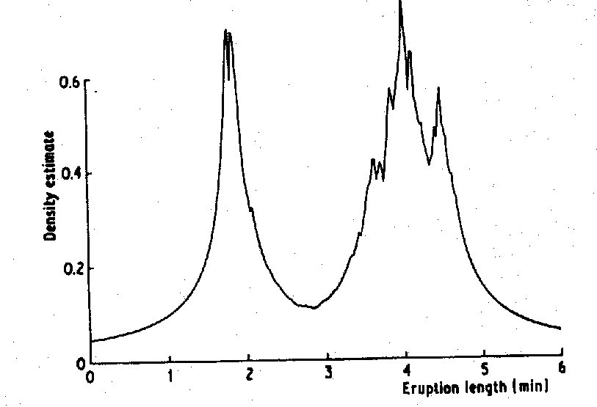
Advantages:
It does not depend on the origin and k can be determined in a “natural” way as n^{1/2}
Disadvantages:
It’s continuous, but it
may not be derivable
K=2

Slide 17
NN estimator with kernel
We use the kernel functions in the NN method
It’s like the kernel estimator but with a variable h parameter that is self-adapted to each point.

Slide 18
Advantages:
Does not depend of any origin and k can be determined in a “natural” way as n1/2
Continuous and derivable

Slide 19
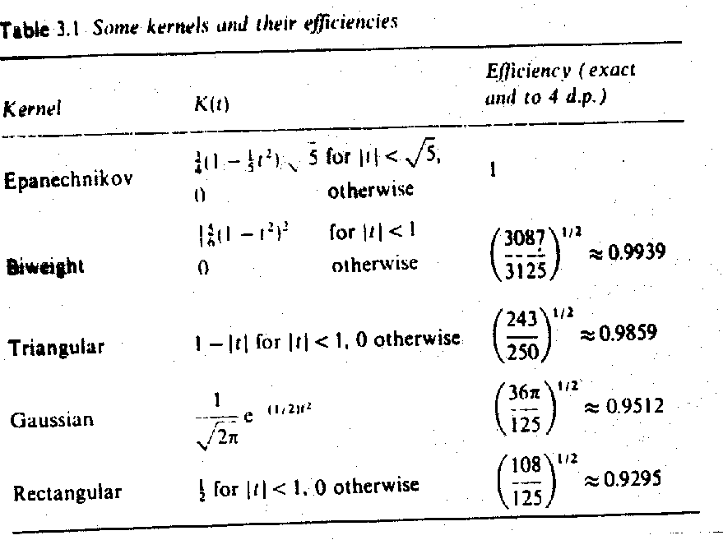
Question: which kernel function should we use?

Slide 20
The properties of the kernel methods are well known:
Biases
Error of the estimator
Optimisation techinques to choose the best smoothing factor
See Silverman (1986) for a discussion. Specifically see the discrepancy measures between an estimator and the PDF

Slide 21
Extension of the kernel methods to multivariate data
The use of a single smoothing coefficient is usually enough if the data have been standardized

Slide 22
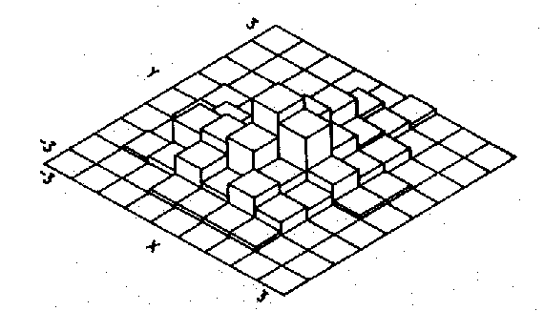
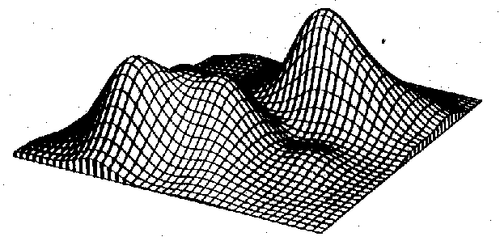
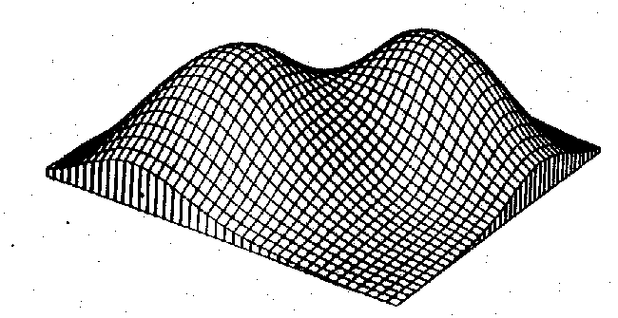
Example from R. Asiain Ph.D.
Bivariate normal
distributions
Histogram
Kernel estimation h=1.2
Kernel estimation h=2.2

